Slide 1
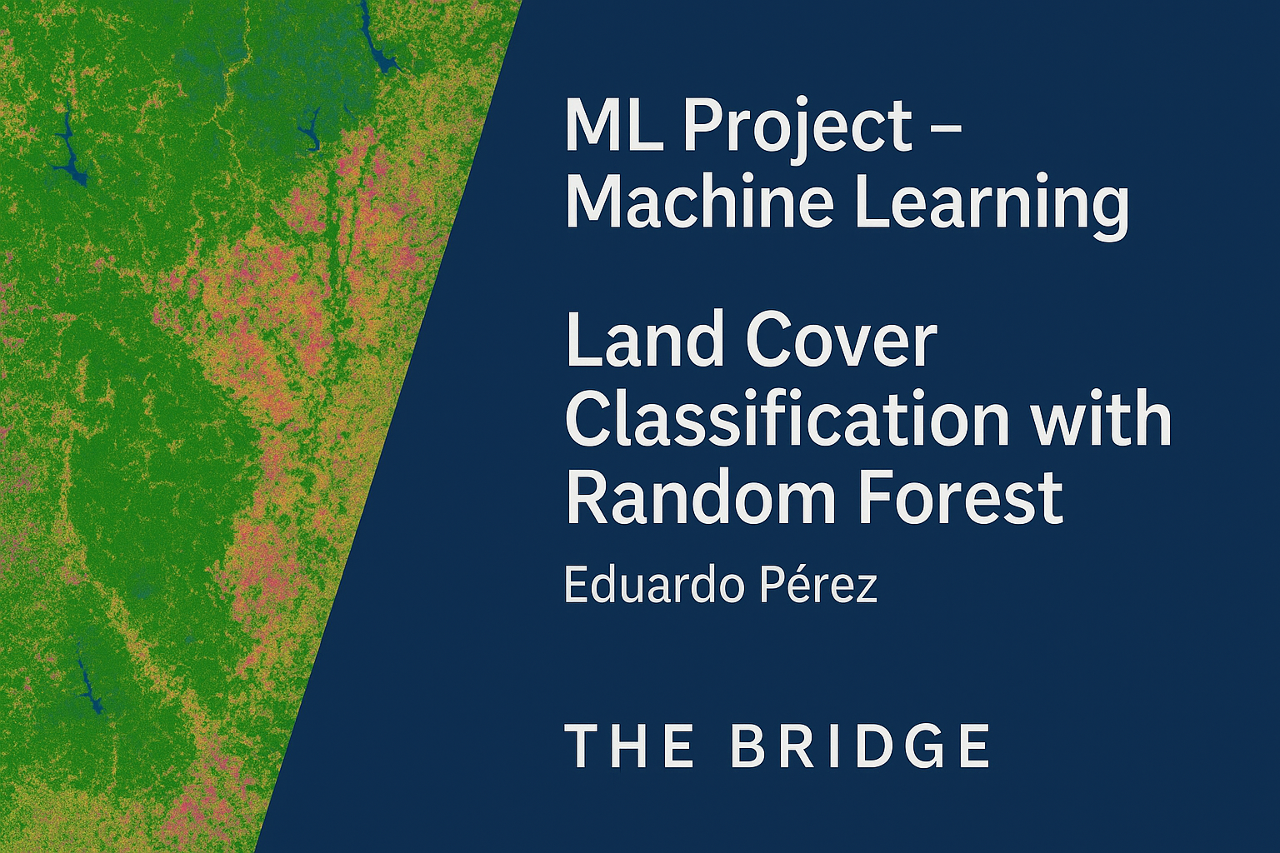


Slide 2
Project Description
In mining, geology, and environmental management, accurately identifying land cover is essential for planning infrastructure, preventing erosion, and preserving ecosystems.
The objective was to train a model capable of automatically classifying seven different types of forest cover using variables such as elevation, slope, soil type, and others.

Slide 3
Dataset
Name: Forest Cover Type Dataset
Source: UCI Machine Learning Repository / Kaggle
Records: 581,012 | Columns: 55
Target: Cover_Type (7 forest cover classes)

Slide 4
Workflow
Exploratory Data Analysis (EDA)
Data Cleaning and Splitting
Training with Random Forest
Evaluation using Confusion Matrix and Classification Report

Slide 5
Model Results
Overall Accuracy: ~96%
High accuracy for majority classes (1, 2, and 3)
Minority classes correctly identified, but with lower precision

Slide 6
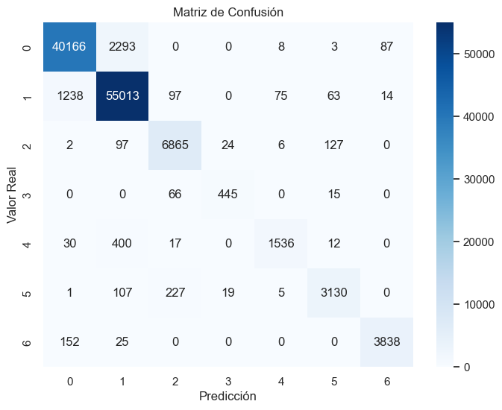
Conclusions
Effective and robust model for structured data
Applicable to real-world geospatial tasks
Potential improvements: class rebalancing, alternative algorithms (XGBoost, LightGBM)
The model accurately predicts most classes
Overall accuracy close to 96%
Improvement opportunity: rebalancing of minority classes

Slide 7
Entrega y Recursos
Repositorio GitHub: código, muestra y modelo .pkl
Notebook limpio y ejecutable
Video explicativo del proyecto
¡Gracias por su atención!

